Slide 1
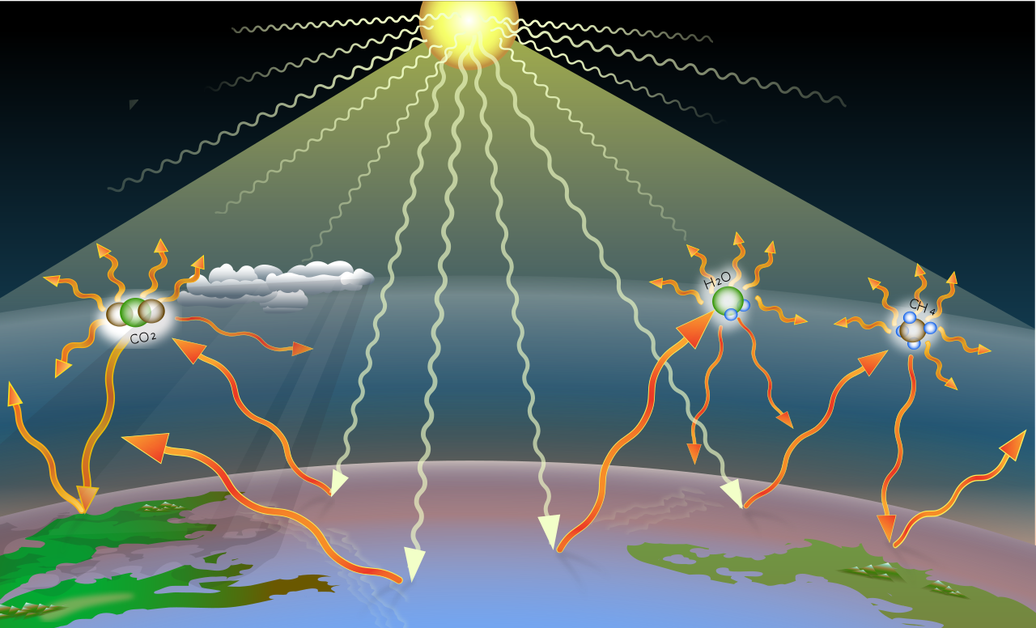
Wdh. The natural greenhouse effect
Explain what the things in the illustration stand for.
i.e.: Nr. 1 stands for …..
1
6
4
2. Explain how the
greenhouse effect works.
You may use these words:
- pass through
- absorb
- send back
- trap
2
5
3

Slide 2
Wdh. The natural greenhouse effect
CO₂
N₂O
CH₄
Name the three
greenhouse gases.

Slide 3
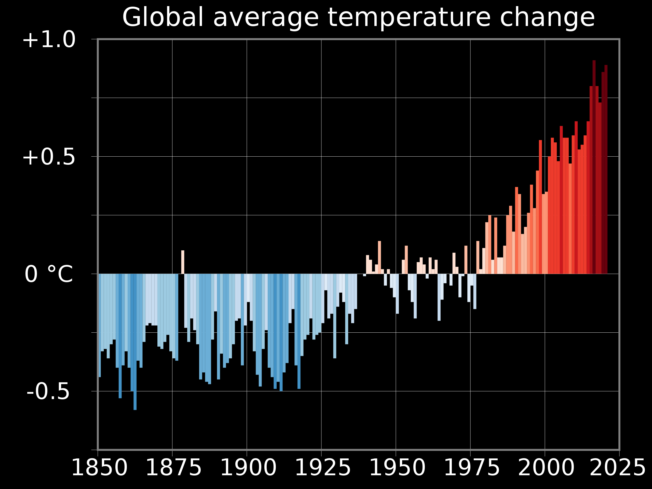
The anthropogenic greenhouse effect
Describe the trend of the global surface temperature from 1850 until 2025
These words might help:
rise, increase slowly, sharply
fall, decrease slowly, sharply
the coldest, hottest years
change, not much change
(Reference period: 1971 – 2000)

Slide 4
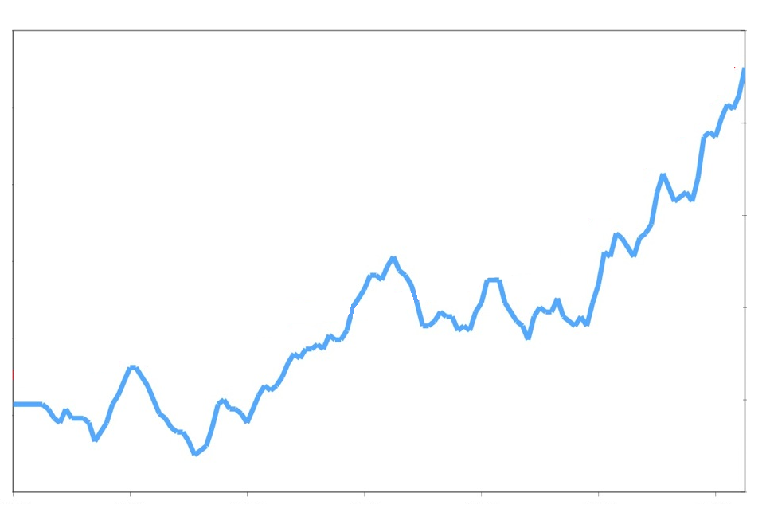
The anthropogenic greenhouse effect
°C
14.6
14.4
14.2
14.0
13.8
13.6
Global surface temperature
Compare the global surface temperature and
the concentration of greenhouse gases in the atmosphere.
1880 1900 1920 1940 1960 1980 2000
Carbon Dioxide (CO₂)
Methane (CH₄)
Nitrous oxide
(N₂O)

Slide 5
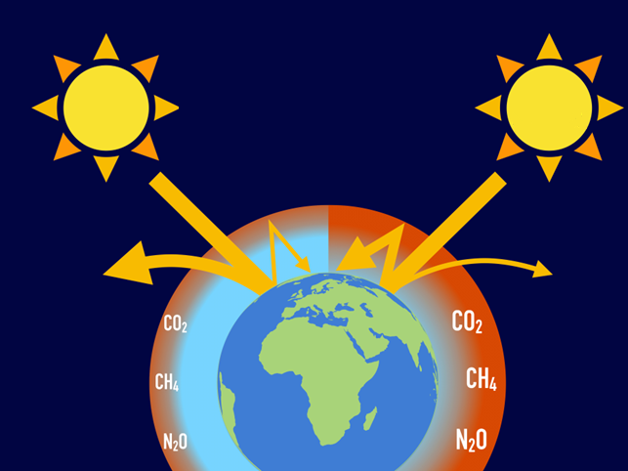
The anthropogenic greenhouse effect
Which sentences belong to which numbers?
- More heat is trapped.
2
4
3
- Less heat is trapped.
- More heat escapes to space.
1
- More heat is re-emitted to
Earth.
5
- There is a higher concentration
of greenhouse gases.
until 1850
today
The natural
greenhouse effect
The anthropogenic greenhouse effect

Slide 6
The anthropogenic greenhouse effect
CO₂
N₂O
CH₄
Guess which human-caused greenhouse emissions cause the greenhouse effect most.
?

