Slide 1
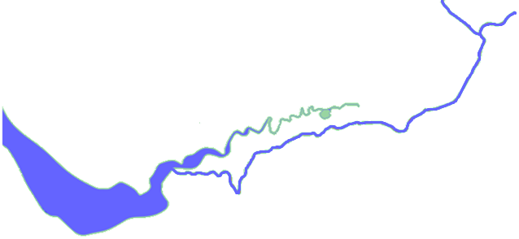
Liverpool - Manchester Railway
Manchester
Liverpool
Mersey River
Bridgewater Canal
Changes in transport – Liverpool-Manchester-Railway

