Slide 1
The directions
N
= North
W
E
= West
= East
S
= South

Slide 2
N
The directions
W
E
S
Never
Eat
Slimy
Worms

Slide 3
The directions
north
north-west
north-east
west
east
south-west
south-east
south

Slide 4
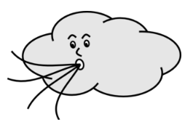
The directions
The wind blows from the east.

Slide 5
The directions
The wind blows from the north-west.

Slide 6
The directions
The wind blows from the south.

Slide 7
The directions
The wind blows from the south-east.

Slide 8
The directions
The wind blows from the west.

Slide 9
The directions
The wind blows from the north.

