Slide 1
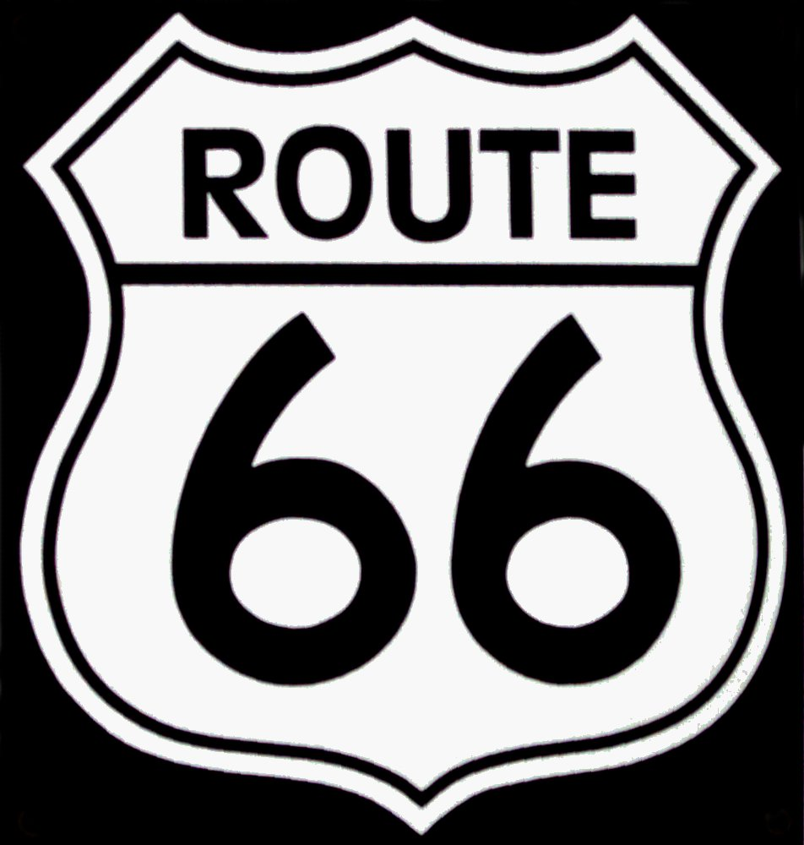
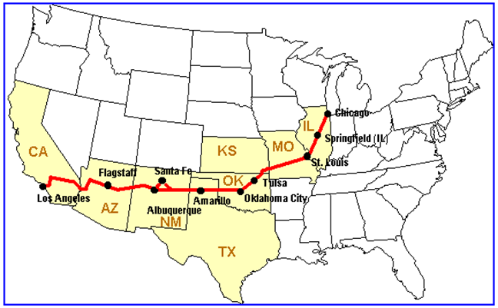
How far is it from Chicago to Los Angeles?
a) on Route 66
On Route 66 the distance from Chicago to Los Angeles is about 4,000 kilometres.
https://en.wikipedia.org/wiki/File:Flag_of_the_United_States.svg

Slide 2
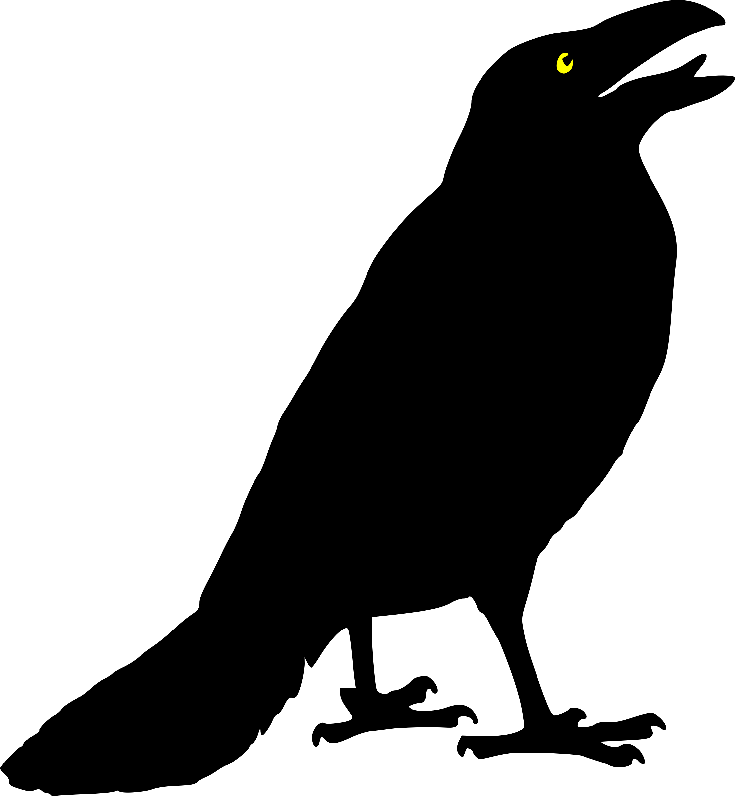
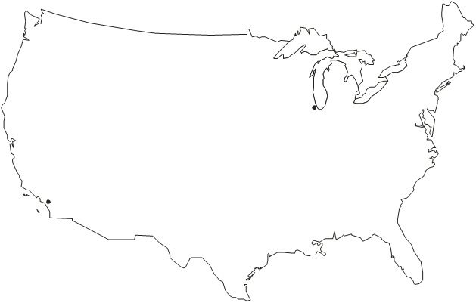
How far is it from Chicago to Los Angeles?
a) as the crow flies
As the crow flies the distance from Chicago to Los Angeles is about 2,800 kilometres.
Chicago
Los Angeles

