Slide 1
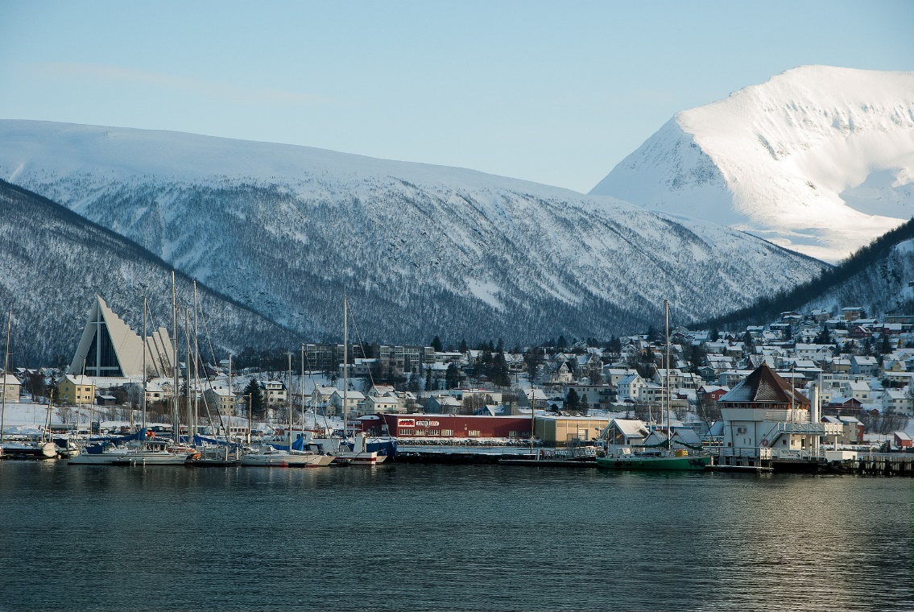
Tromsø in March
Describe the picture.
- in the foreground, in the background
- in the middle, on the top, at the bottom
- on the right/left …
The cold zone

Slide 2
Tromsø in March
Guess where Tromsø is located.
“Maybe, I think, I guess …, because …”
The cold zone

Slide 3
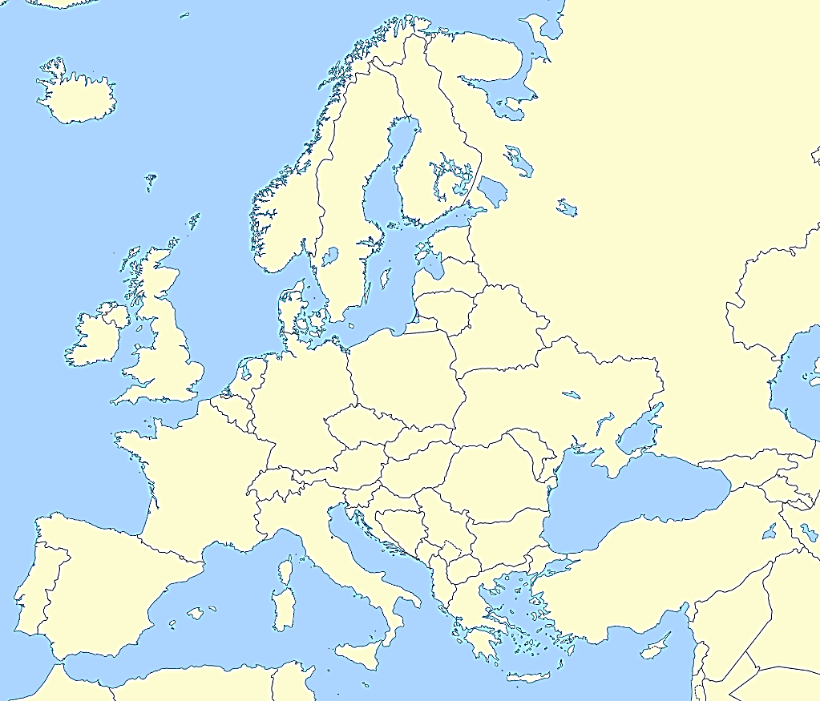
Tromsø in March
Tromsø
Say where Tromsø is located:
continent
country
sea
The cold zone

